Slide 1
Module 16
Techniques under Development in
Managerial Accounting

Slide 2
Target Costing
Target costing has been developed to help companies manage their costs in circumstances when the selling price is known.
Target costing may set a cost before the product is created or even designed.
Once the target price is known, the desired profit margin can be deducted in order to determine the target cost beyond which the company would consider it uneconomic to produce and sell the product.
Target Costing = Target Selling Price - Target profit Margin

Slide 3
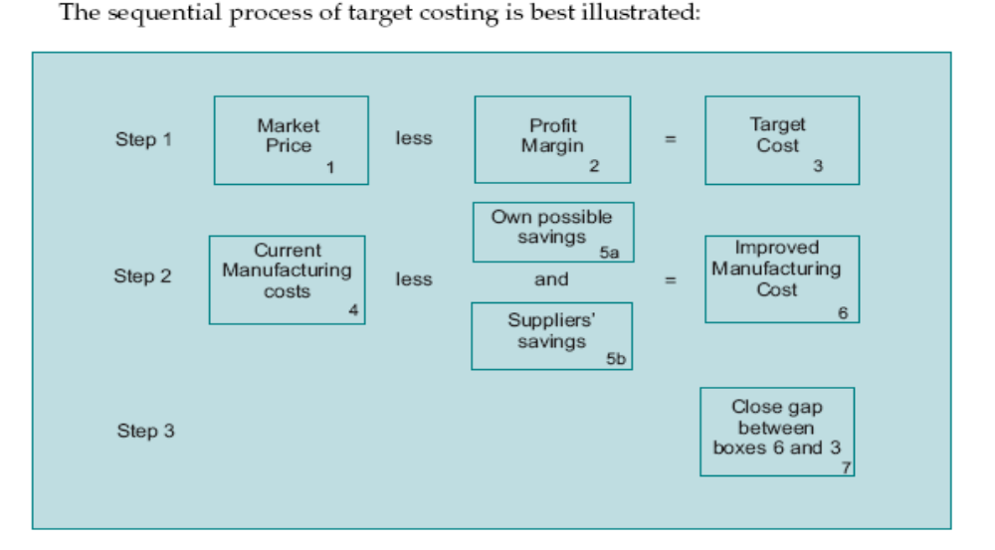
Target Costing

Slide 4
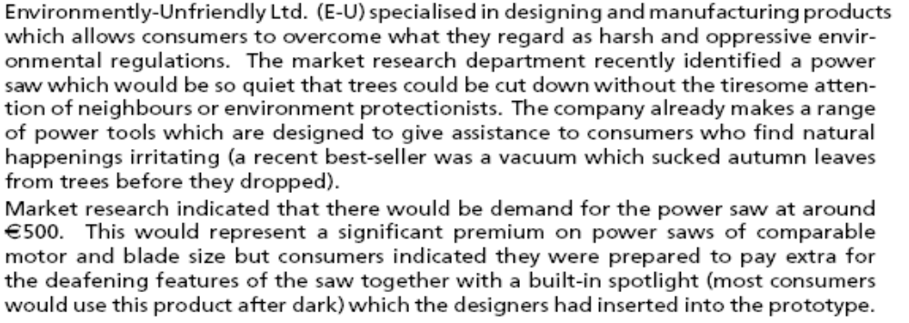
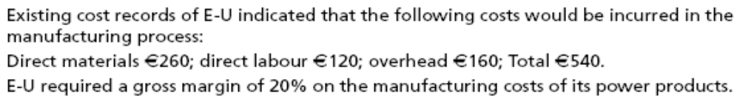
Example P.16/5

Slide 5
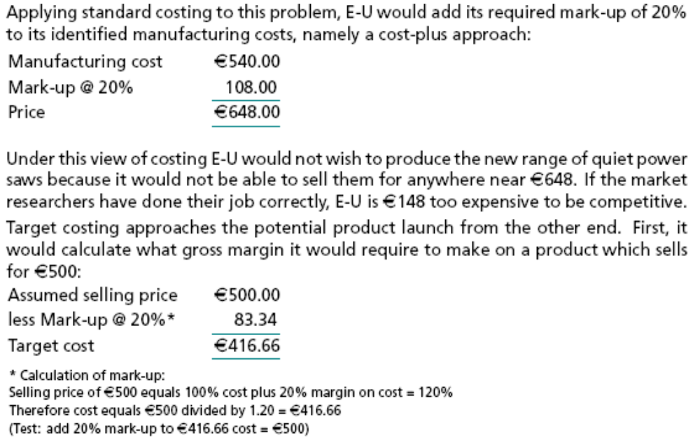

Slide 6
Life Cycle Costing
Life cycle costing has a similar future time focus, from the moment a product or service is conceived in the R&D laboratory or in the mind of a service deliverer until the product or service is withdrawn and all associated customer services associated with the product or service are also withdrawn.
Life cycle costing gathers all revenues and costs associated with a product or service over its whole lifespan so that its ultimate profitability can be measured and management decisions taken thereon.

Slide 7
Example of life cycle costing
Take the computer industry as an example of the problems associated with the cycles: rapid advances in technology lead computer companies to withdraw models perhaps as often as every 12 months. But because customers keep the models they purchase for perhaps five (or even more) years the supplier is obliged to keep a supply of spare parts and engineering know-how to service the machine until it goes out of service.

Slide 8
Throughput Accounting
A business can only earn profits if the rate at which it earns money from sales is greater than the rate at which it spends money on production.
The throughput ratio allows management to direct its business by helping managers to concentrate on current production constraints.
Throughput accounting stresses that products do not earn profit, Profit earning is realized by selling products.

Slide 9
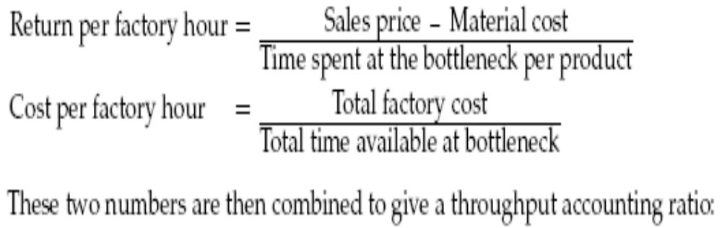
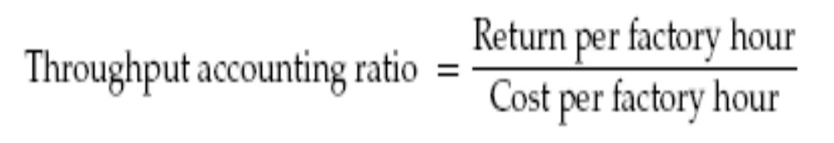
Throughput Accounting
Proponents use measures of return per factory hour and cost per factory hour in calculating a throughput ratio:

Slide 10
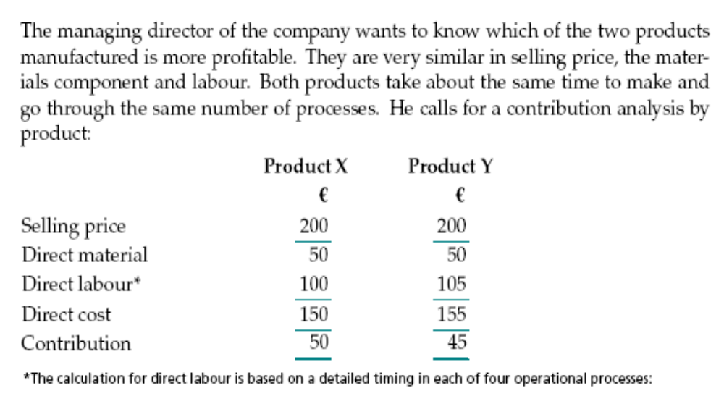
Example

Slide 11
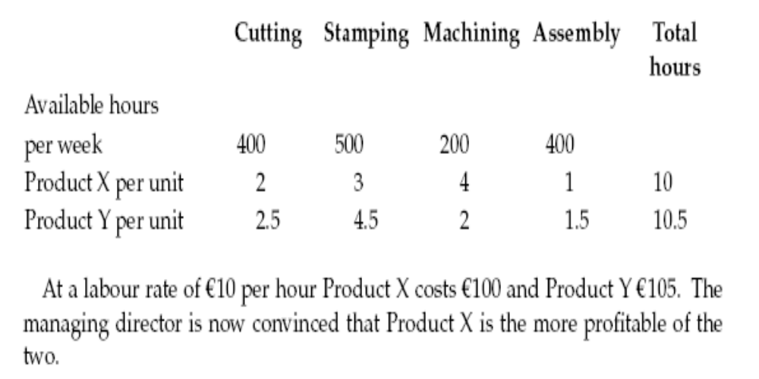
Example

Slide 12
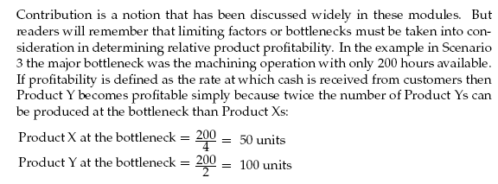
Bottleneck impact on Profitability

Slide 13
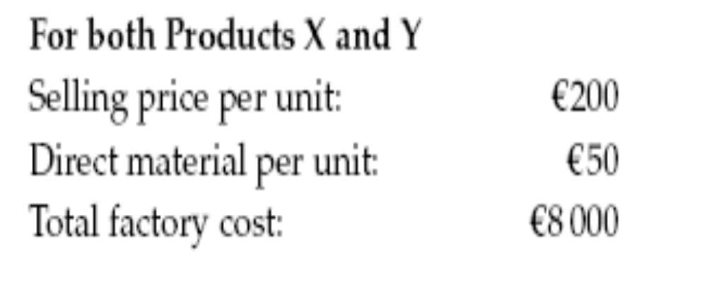
Throughput Accounting
The throughput ratio informs management about the rate at which products earn money for the business. A ratio less than one indicates that a product is losing money. Extending our example we can see the throughput accounting ratio in action:

Slide 14
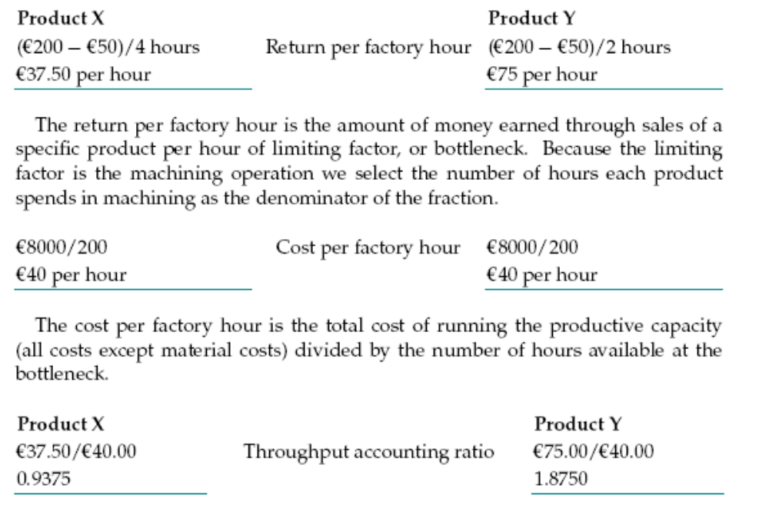
Product Profitability

Slide 15
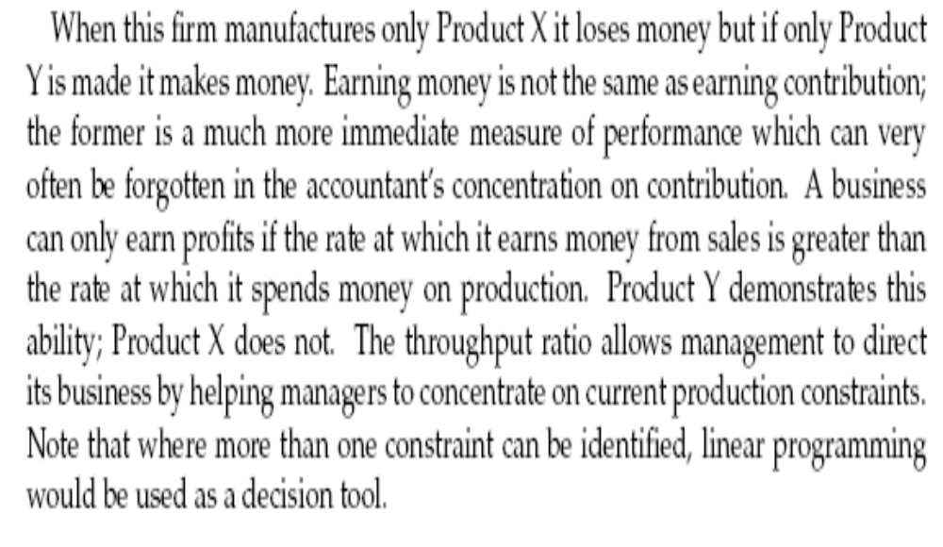
Product Profitability

Slide 16
The Balanced Scorecard
Traditionally Managerial Accounting focused mainly on financial performance measures.
Greater emphasis now being given to incorporating non-financial measures into the formal reporting system.
Its Result was a proliferation of performance measures.
It integrates financial and non-financial measures the Balanced Scorecard (BSC) emerged.
BSC seeks to link performance measures to an organization’s strategy — Should be used to clarify, communicate and manage strategy.
The balanced scorecard translates an organization’s mission and strategy into a set of performance measures that provides the framework for implementing its strategy
It is called the balanced scorecard because it balances the use of financial and nonfinancial performance measures to evaluate performance

Slide 17
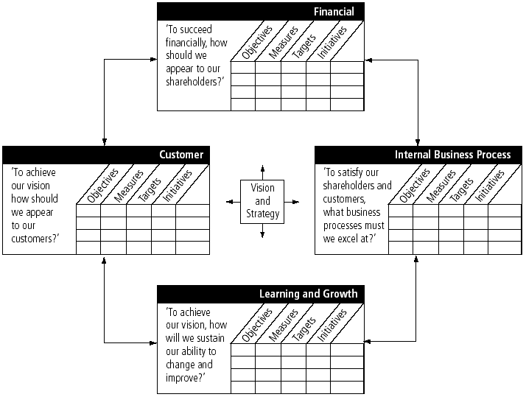
The Balanced Scorecard (Source: Kaplan and Norton, 1996b)

Slide 18
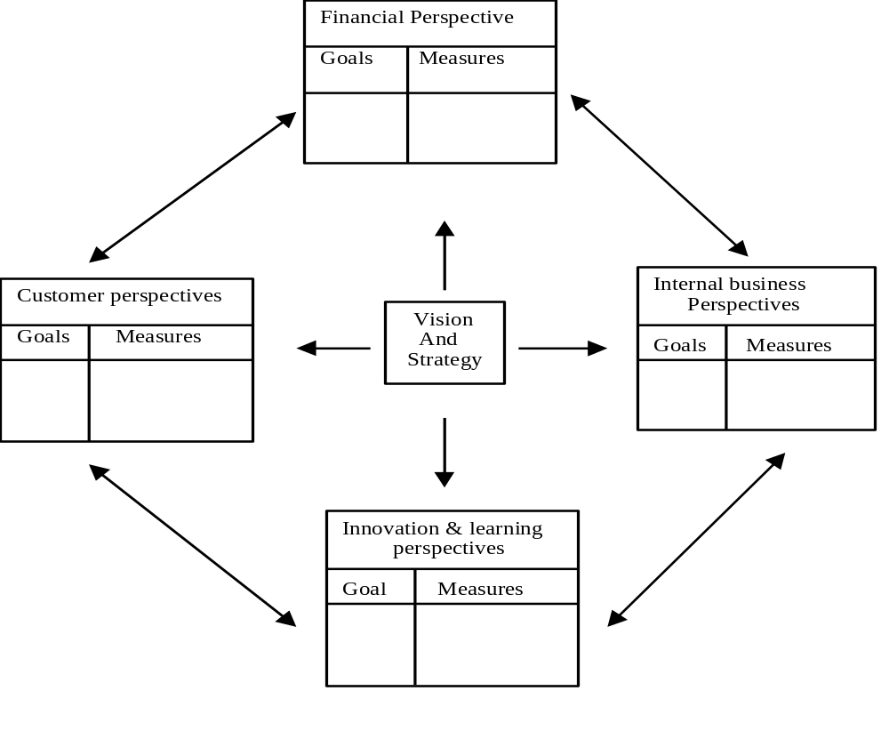
Basics of the BSC

Slide 19
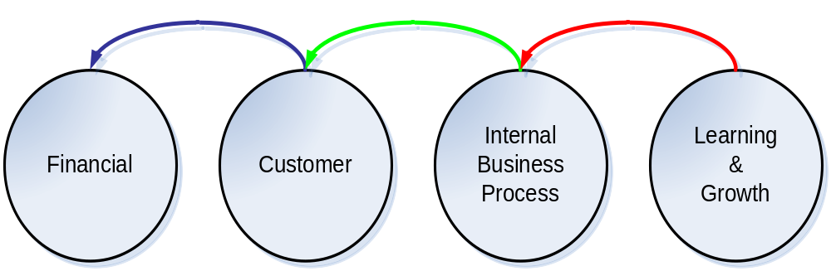
Balanced Scorecard Perspectives
Learning and Growth
Internal Business Processes
Customer
Financial

Slide 20
Balanced Score Cards
BSC Advocates looking at the business from four different perspectives by seeking to provide answers to the following four basic
questions:
  How do customers see us? (customer perspective)
  What must we excel at? (internal business process perspective)
  Can we continue to improve and create value? (learning and growth perspective)
  How do we look to shareholders? (financial perspective)
To implement the BSC the major objectives for each of the 4 perspectives should be articulated and these objectives should be translated into specific performance measures.
A critical assumption of BSC is that each performance measure is part of a cause-and-effect relationship.

Slide 21
Balanced Score Cards
BSC puts strategy, structure, and vision at the center of management’s focus
BSC emphasizes an integrated combination of traditional and nontraditional performance measures, it keeps management focused on the entire business process and helps ensure that actual current operating performance is in line with long-term strategy and customer values.
The framework of the BSC provides a balance between short and long term objectives, financial and nonfinancial measures, and external and internal performance indicators.

Slide 22
Weaknesses of the BSC
Balanced Score Cards
Strengths of the BSC
    Ability to translate an organization’s vision and strategy into tangible objectives and measures.
    Focus on a limited number of critical measures
    Strong focus on customer and market.
    Flexibility and adaptability to fit each organization in particular.
    Easy to use.
    It focuses on customers, forgetting other important stakeholders.
    Only focus on results.
    It focuses primarily on top-down performance measurement.

Slide 23
The Learning and Growth Perspective
The learning and growth perspective:
• Identifies the capabilities the organization must excel at to achieve superior internal processes that create value for customers and shareholders
Focuses on the infrastructure that the business must build to create long-term growth and improvement.
• Three principal categories are identified in this area :
  Employee capabilities
  Information system capabilities
  Motivation, empowerment and alignment

Slide 24
The Internal Business Processes
Focuses on internal operations that create value for customers that, in turn, furthers the financial perspective by increasing shareholder value
Includes three sub-processes:
  Innovation
  Operations
  Post-sales service

Slide 25
The Internal Business Processes
• Critical internal processes for which the organization must excel (e.g. innovation, operation and post-service sales processes).
• Typical innovation measures include:
  Percentage of sales from new products.
  New product introduction versus competitors.
  Product development break-even time.
• Typical operation process measures include:
  Cycle time
  Quality
  Activity and process costs
• Post-sales service processes:
  Develop appropriate time, quality and process measurements.

Slide 26
The Customer Perspective
Identifies targeted customer and market segments and measures the company’s success in these segments
Typical generic measures include:
  1-Market share
  2-Customer retention and loyalty
  3-Customer acquisition
  4-Customer satisfaction
  5-Customer profitability

Slide 27
The financial Perspective
The financial perspective:
• Typical measures include ROI, RI and EVA TM
• Besides targets for the above, other objectives include revenue growth, cost reduction and asset utilization.
• Argued by some that by focusing on other perspectives, financial measures will take care of themselves.
Evaluates the profitability of the strategy
Uses the most objective measures in the scorecard
The other three perspectives eventually feed back into this dimension

